Slide 1
Assignment – hyperparameter tuning
Name : Pooran Pragnya
November Batch (BDS)

Slide 2
Hyperparameter tuning
It is the process of determining the right combination of hyperparameters that allows the model to maximize model performance.
It is choosing a set of optimal hyperparameter for learning a algorithm.
Setting the correct combination of hyperparameter is the only way to extract the maximum performance out of models.
Hyperparameter cannot be directly learned from the regular training process. They are usually fixed before the actual training process begins. These parameters express important properties of the model such as its complexity or how fast it should learn.

Slide 3
Some examples of model hyperparameters are:
The penalty in logistic regression classifier i.e L1 or L2 regularization.
The leaning rate for training a neural network.
The C and Sigma hyperparameters for support vector machine (SVM).
The K in KNN.

Slide 4
Techniques of hyperparameter tuning
1. Grid Search
2. Random Search

Slide 5
Grid search
Here we try every combination of present list of values of the hyperparameters and evaluate the model for each combination. The pattern followed here is similar to the grid, where all the values are placed in the form of matrix. Each set of parameters is taken into consideration and the accuracy is noted. Once all the combinations are evaluated, the model with the set of parameters which give the top accuracy is considered to be the best.
This approach is called GridSearchCV because it searches for best set of hyperparameters from a grid of hyperparameters values.

Slide 6
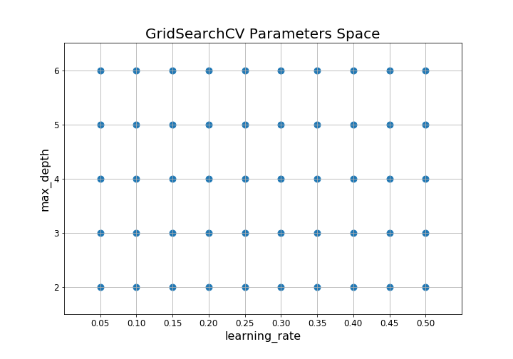

Slide 7
Limitations of Grid search:
It is very slow.
If we pass multiple parameters then size of grid will increase, iteration will increase and it will be very time consuming process.
It takes a lot time as well as larger memory.
In every point, in the grid needs K-Fold cross validation, which requires K training steps so tuning the hyperparameters of a model in this way can be quite complex and expensive.

Slide 8
Random search
It is a technique where random combinations of the hyperparameters are used to find the best solution for the built model.
Random search is similar to grid search but instead of using all the points in the grid, it tests only a randomly selected subset of these points.
This approach reduces unnecessary computation.
It saves both time and memory as compared to grid search method.

Slide 9
